Slide 1
Predicting Insurance Premiums with Machine Learning
By:
AJIGBOTOSHO Hammed Olaitan
Fe/24/8521502061

Slide 2
Overview
Objective:
Develop a predictive model to estimate insurance premiums balancing competitiveness and profitability.
Key Deliverables:
Data loading and Preprocessing
Feature engineering framework
Optimized machine learning model (R2: -0.265)
Actionable business insights
Business Impact:
Accurate Pricing
Risk assessment improvement
Customer segmentation

Slide 3
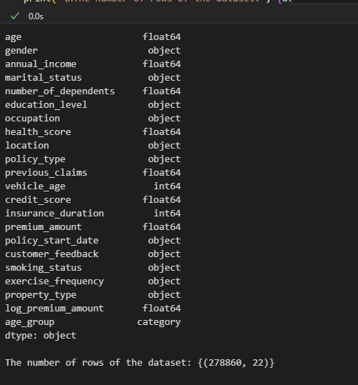
DATA SOURCE
This dataset was obtained from Secure life Insurance Co website. It contains: 278860 rows and 22 columns.

Slide 4
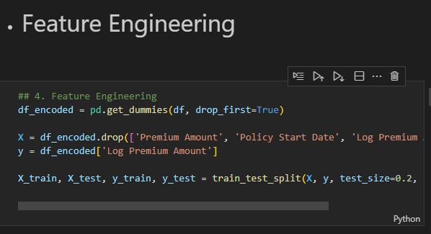
FEATURE ENGINEERING

Slide 5
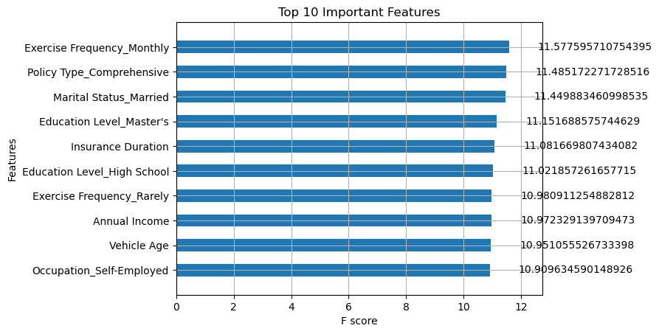
MODEL PERFORMANCE
XGBOOST MODEL:
MAE: 674.0349819873801
MSE: 1004956.3509297046
R2 Score: -0.20653192401370424
LINEAR REGRESSION EVALUATION:
MAE: 674.0445984534173
MSE: 1004951.2408799762
R2 Score: -0.20652578898293905

Slide 6
BUSINESS INSIGHTS
KEY INSIGHTS:
- Income, Credit Score, Health Score, and Claims History are highly predictive of premium.
Log transformation improved model accuracy significant
XGBoost slightly outperforms Linear Regression
Both models are underfitting based on the negative R² score. A negative R² means the model performs worse than simply linear predicting the mean of the target.
However, XGBoost has:
Lower MAE and MSE
Slightly better R².yst.
Policy Age and Vehicle Age are also strong premium indication

Slide 7
CONCLUSION
Conclusion
This project successfully demonstrates how data-driven approaches can improve premium prediction accuracy for Secure Life Insurance Co.
Data preprocessing, such as handling missing values, encoding, and log transformation, significantly improved model stability.
XGBoost was the best performing model, though further tuning and more complex feature interactions could enhance results.
This work provides a solid foundation for building an intelligent insurance pricing system.

